Slide 1

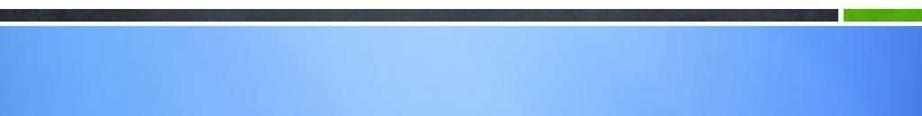
MODULE-14
WEB SERVICES AND PROJECT

Slide 2
Course Topics
→ Module 1
» Introduction to Java
→ Module 8
» Servlets
→ Module 2
» Data Handling and Functions
→ Module 9
» JSP
→ Module 3
» Object Oriented Programming in Java
→ Module 10
» Hibernate
→ Module 4
» Packages and Multi-threading
→ Module 11
» Spring
→ Module 5
» Collections
→ Module 12
» Spring, Ajax and Design Patterns
→ Module 6
» XML
→ Module 13
» SOA
→ Module 7
» JDBC
→ Module 14
» Web Services and Project

Slide 3
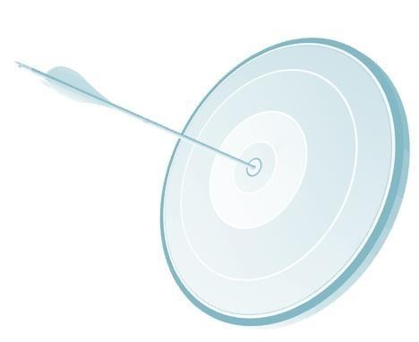
Objectives
At the end of this module, you will be able to
→ Understand Web Services and its types
→ Implement WSDL File
→ Create a SOAP based web service
→ Create a RESTful web service
→ Get the glimpse of the final Project

Slide 4
Web Services

Slide 5
Web Services – Introduction
A web service is a piece of business logic, located in some location on internet, that is accessible through HTTP.
A web service could be as simple as visiting a web site or as complex as facilitating a multi organization
operations.
Characteristics of a Web Service:
→ Data can be exchanged using XML format.
→ Loosely coupled.
→ Ability to be Asynchronous or Synchronous.

Slide 6
Why Web Services
From Business Point:
Integration
→ with in an organization
→ between companies
→ allows time/cost efficiencies
» Purchase orders.
» Answering enquiries.
» Processing shipment requests and many more

Slide 7
Examples of Using Web Services
→ A stock quote service:
An application needs current value of the given stock then web service can return it.
→ A route finder for delivery of goods:
Given the initial and final location, find the most cost-effective delivery route.
→ A weather service:
An application wants to get a regular update of weather then a web service can be used which provides this service.

Slide 8
Web Services
Web services can be implemented either using
→ SOAP – Simple Object Access protocol. Uses XML for exchange of data.
→ Restful Services – Uses HTTP protocol to access the web service.

Slide 9





Web Services - SOAP
Client interacts with the service using SOAP message. SOAP is written in XML
Client
Services
JAX-WS runtime
SOAP message
JAX-WS runtime

Slide 10




Web Services - SOAP
→ Web Service is published in UDDI registry
→ UDDI stands for Universal Description, Discovery and Integration
→ Client looks in the registry for the services and gets connected with the required service and interacts with it
UDDI
Registry
locate/get description UDDI
register/publish UDDI
Web Service Requestor
Web Service Provider
invoke SOAP

Slide 11




Web Services Interaction - SOAP
Application
SOAP
Client
HTTP Request
SOAP Processor
HTTP Response
Discrete Business Logic
WSDL
Service

Slide 12
Web Services - SOAP
→ Client data is converted into XML using SOAP format. It is sent on internet.
→ SOAP message is parsed by the service at the server side.
→ Data and the required information is understood.
→ Performs the client request and returns back the data to client in SOAP format.

Slide 13
SOAP
→ SOAP stands for Simple Object Access Protocol
→ SOAP is used for communicating between two applications
→ SOAP is a format for sending messages
→ SOAP communicates via Internet using HTTP
→ SOAP is platform independent
→ SOAP is written using XML
→ SOAP is a W3C recommendation

Slide 14
SOAP Format
→ SOAP Envelope – This the root element of a SOAP message.
→ SOAP Header – It is optional and used to specify application specific information.
→ SOAP Body – This portion contains the actual SOAP message which needs to be sent to the web service. It also includes the data which needs to be sent the server.

Slide 15

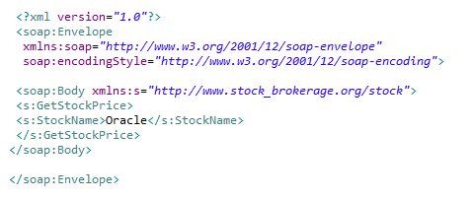
Example of SOAP Request

Slide 16

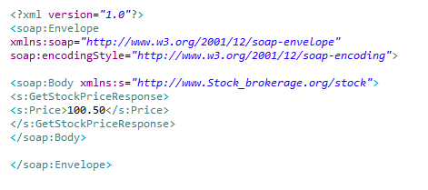
Example of SOAP Response

Slide 17
WSDL
→ WSDL is Web Services Description Language
→ WSDL is written in XML and it is a XML document
→ WSDL describes the Web services
→ WSDL is a W3C recommendation

Slide 18
WSDL
WSDL XML document has the following elements:
→ <types> - This section is used to specify the data types used by the web services.
→ <messages> - Messages for communication will be specified in this section. Input message and output message can be specified in this section.
→ <portType> - This defines the web service and the operations / methods to be executed. Also the messages that are involved in this operation /method. Messages could be input message and output message.
→ <binding> - This section defines the message bindings and transportation protocol.
→ <service> - Location of the service – URL.

Slide 19

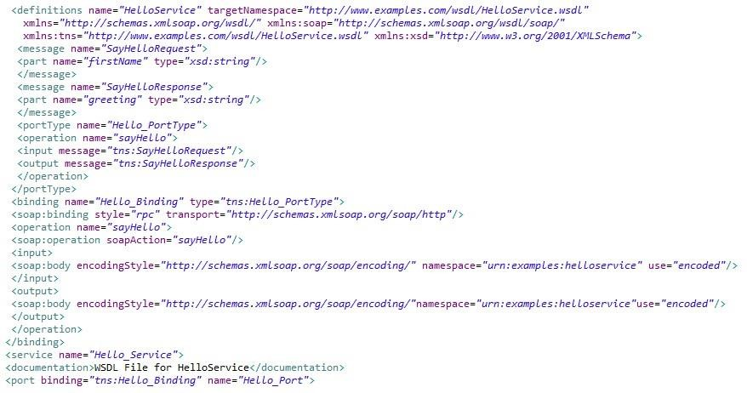
Example of WSDL File

Slide 20
Apache Axis
Apache Axis (Apache Extensible Interaction System) is an open-source, XML based Web service
framework.
It consists of a Java and a C++ implementation of the SOAP server, and various utilities and APIs for generating and deploying Web service applications. Using Apache Axis, developers can create interoperable, distributed computing applications.
Apache Axis can be integrated with Eclipse.
You can download Apache Axis for Eclipse from this site:
https://axis.apache.org/axis2/java/core/tools/eclipse/plugin-installation.html
Apache Axis generates the WSDL code and the required client

Slide 21

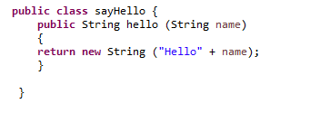
Web Services Development using SOAP
→ Download Apache Axis2 and integrate with eclipse.
→ Create a Dynamic Web Project from Eclipse.
→ Create a class under Src Directory.
→ Write a public function. It could be like as given below:

Slide 22
Web Services Implementation
→ Select the Java file from eclipse project explorer.
→ Right click on it and select web services and select and click “create web service”.

Slide 23

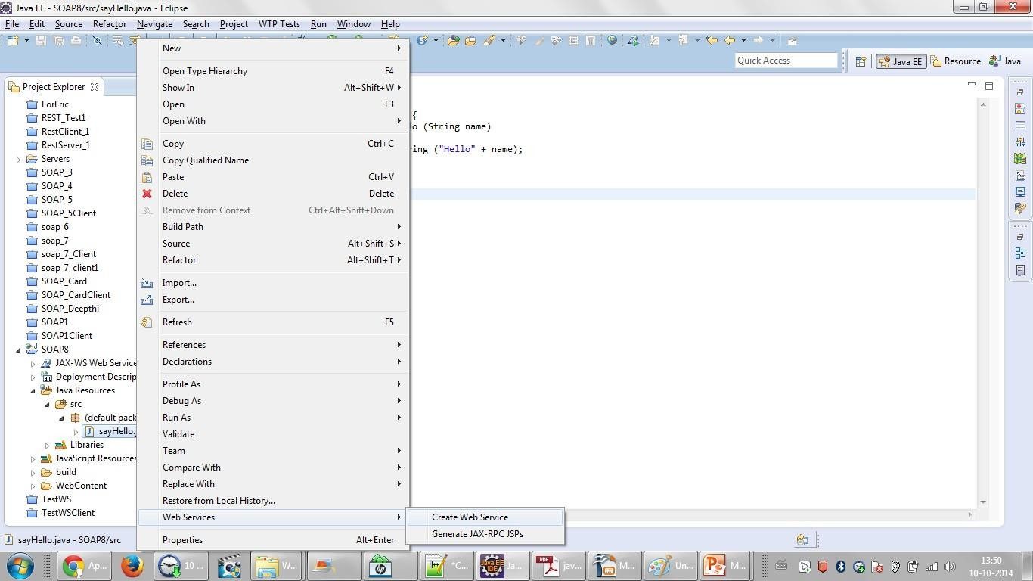
Web Services Implementation

Slide 24

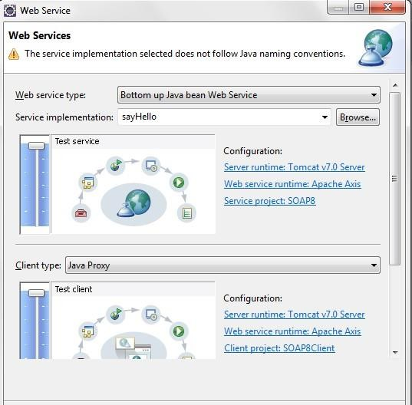
Web Services Implementation

Slide 25

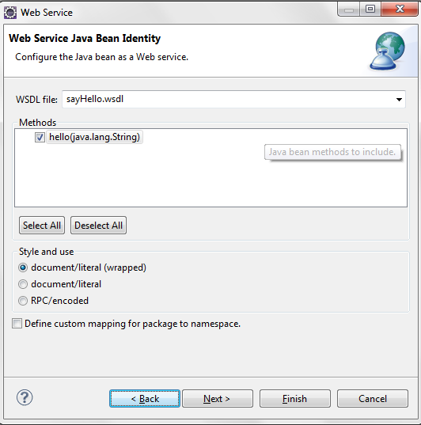
Web Services Implementation

Slide 26

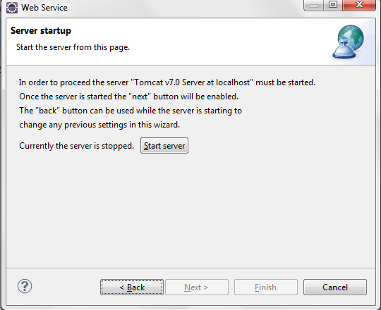
Web Services Implementation

Slide 27
Web Services Implementation
→ Click on start server
→ Click on Finish
→ Click on the function developed

Slide 28

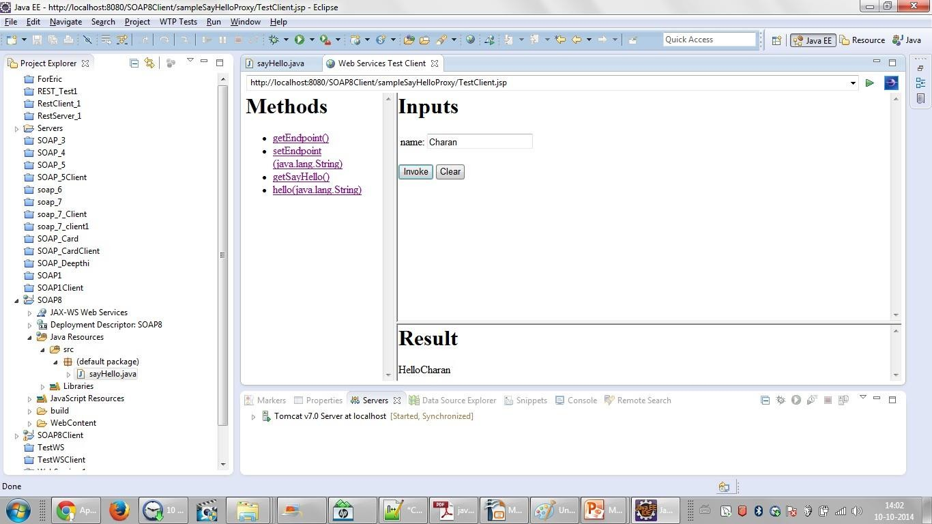
Web Services Implementation

Slide 29
REST Services
→ REST stands for Representational State Transfer
→ This service is developed using HTTP protocol
→ In Rest based architecture, similar to SOAP based Architecture, service is developed in REST and REST client has to be written to use the REST Service
→ Java defines REST support via the Java Specification Request (JSR) 311. This specification is called JAX-RS (The Java API for RESTful Web Services)

Slide 30
JAX-RS
→ Jersey is the reference implementation for JSR (Java Specification Request)-311
→ Jersey provides the library for RESTful Web Services using Servlet container
→ Download Jersey distribution from the site: https://jersey.java.net/download.html

Slide 31
Restful Services
→ REST is an architecture. RESTful service is a service which follows the REST architecture.
→ Following Annotations are used:
» @Path (path) – Sets the path to the base URL. The base URL is the application name, servlet and URL specified in the web.xml.
» @GET – Indicates the following method will address HTTP GET request.
» @Produces – This function will generate the given output. It could be TEXT/HTML/XML formats etc.

Slide 32
Creating Restful Service
→ Create a dynamic web project in eclipse.
→ Add jersey jar files to the build path.
→ Add the web.xml under web content/WEB-INF directory.
→ Add a Java file and add the required code of the service.

Slide 33

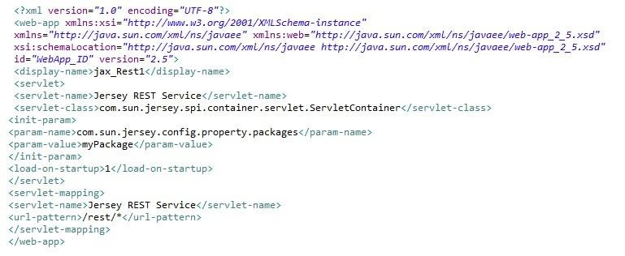
Restful Service – web.xml

Slide 34

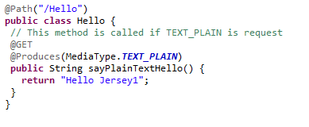


RESTful Service – Java Code

Slide 35
Creating Restful Service
→ Hello should be added for the path of this service.
→ Name of the class is Hello.
→ @GET – The following method will respond to GET method of the client request.
→ @Produces – This method returns the data specified in the Produces annotation.
→ Method returns the data.
→ Run the project so that Service is running on Apache Tomcat.

Slide 36

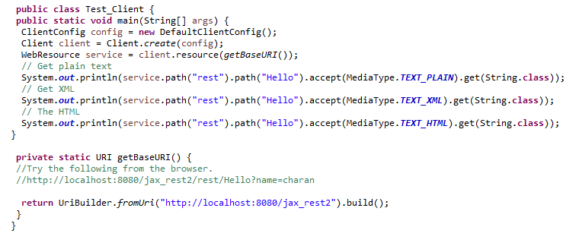
RESTful – Client

Slide 37
RESTful – Client
→ Base URL is obtained for the service.
→ Methods of RESTful services are invoked by using the path and the media type.
→ Apart from writing the client, service can be tested with the URL too
For example:
» http://localhost:8080/jax_rest2/rest/Hello?name=charan
» Here, service is running under 8080 port.
Name of the application is jax_rest2, /rest/Hello is the Path and name=charan is passed as parameter to this service.

Slide 38
PROJECT

Slide 39

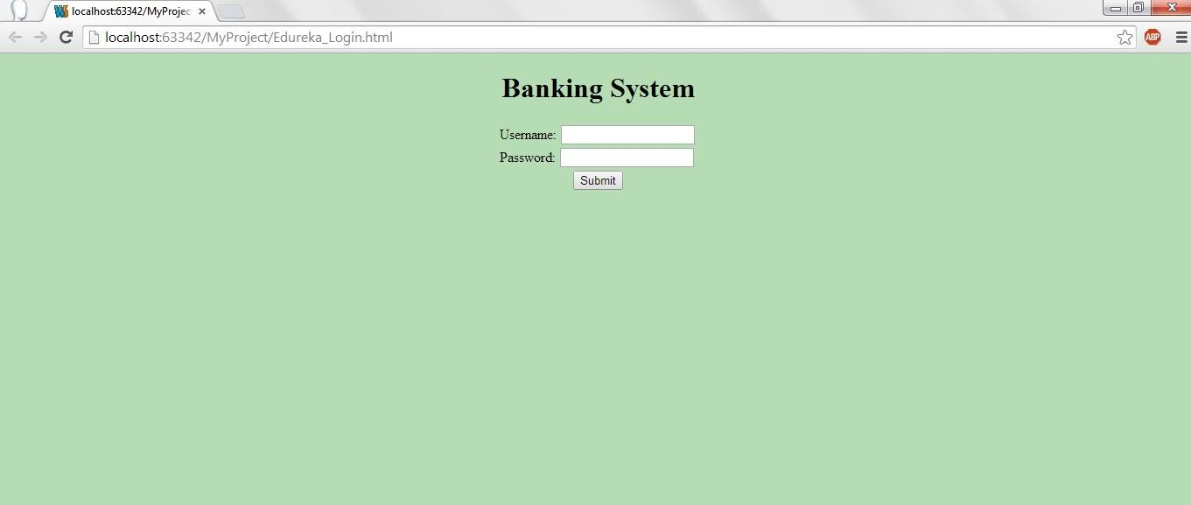
User Login Screen

Slide 40
Login Screen
→ In this screen, user enters the user id and password.
→ Entered user id and password has to be verified from the table user_pass.
→ If the entered user is right, account creation screen is displayed else the message invalid user id/password is displayed to the user.

Slide 41

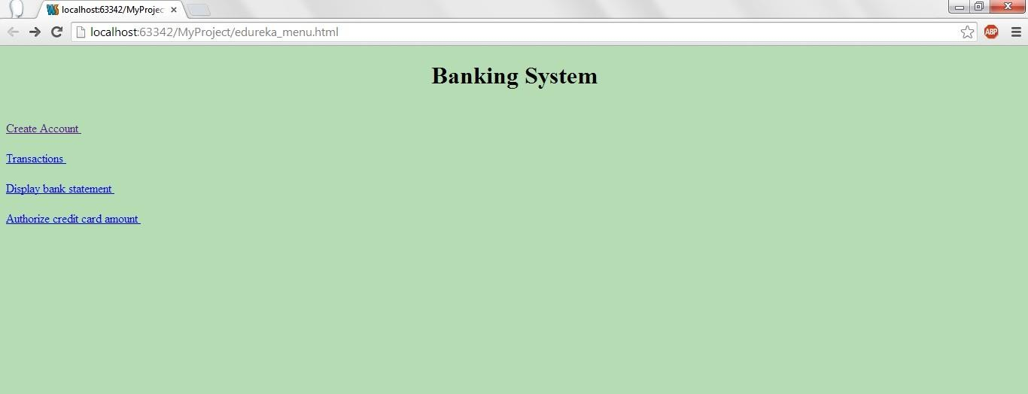
Main Menu Display

Slide 42
Main Menu
→ If the user enters a valid user id and password then this (Main Menu screen) will be displayed.
→ Based on the user's choice corresponding action is taken.

Slide 43

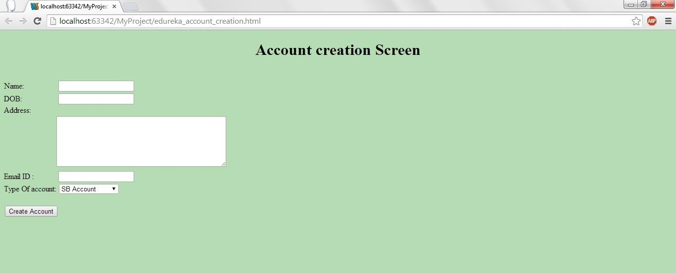
Account Creation Screen

Slide 44
Account Creation
→ In the main menu screen, when the user selects Account Creation, this screen will be
displayed.
→ User will enter the data in this screen and clicks on the create account button.
→ With this, entered data will be entered into the table account_details.
→ After performing this operation, user will be shown the appropriate message as “Account created successfully” or “User Account is not created”.

Slide 45

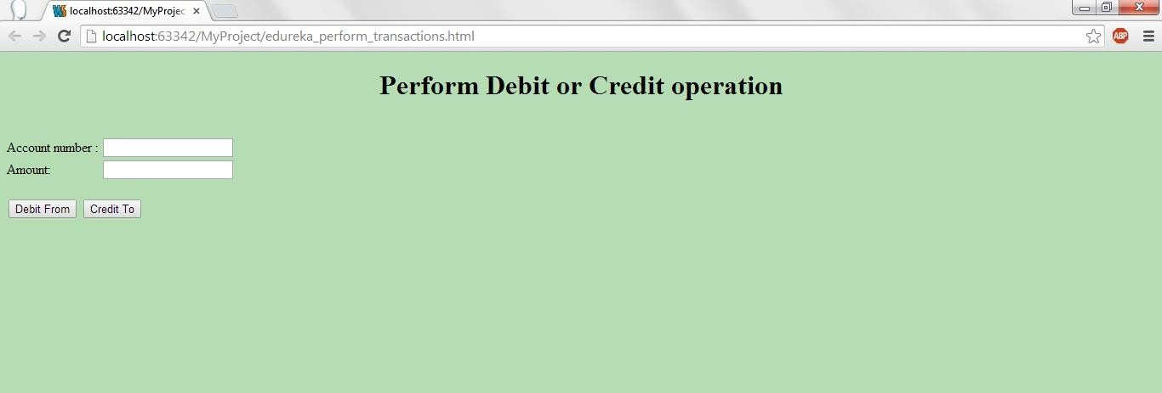
Transactions

Slide 46
Transactions
→ From the main menu, when the user clicks on Transactions, this screen will be displayed.
→ Account number and the amount to be transferred will be entered by the user.
→ If the user clicks on Debit From, the given amount will be debited from the specified account to the logged in user's account. If the chosen option is Credit To, then from the logged in user's account specified amount will be transferred to the given account number.

Slide 47

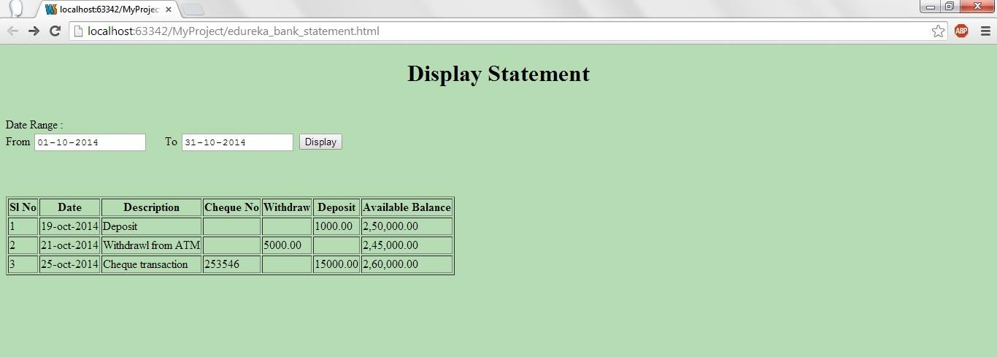
Display Statement

Slide 48
Display Statement
→ When the user selects Display statement from the main menu, this screen will be displayed.
→ User enters the date range and clicks on display button.
→ With the specified date range logged in, user's transactions are displayed in the given format.

Slide 49

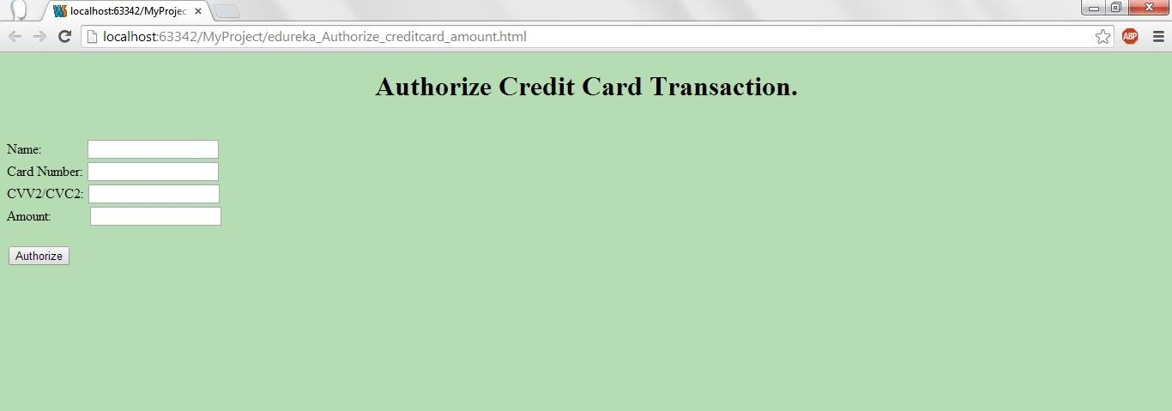
Authorize Credit Card Transactions

Slide 50
Authorize Credit Card Transactions
→ When the user clicks on authorize credit card amount on main menu then this screen will be
displayed.
→ User will enter all the details and will click on Authorize. Using web services this client will get to know whether card holder's credit amount is approved or not. After performing this operation, appropriate message should be displayed to the user as Approved or Rejected.

Slide 51

Say Bye to John!!
That’s all Folks!!
This is the end of our Java Journey. But your learning doesn’t stop here. Do keep checking the LMS to learn more and keep practicing.
Remember to attempt the Project.

Slide 52

QUESTIONS

Slide 53

Assignment
Practice the SOAP and RESTful Web Services given as the example in the class.
Note: You will find the examples under sample programs in the LMS.

Slide 54



